Slide 1
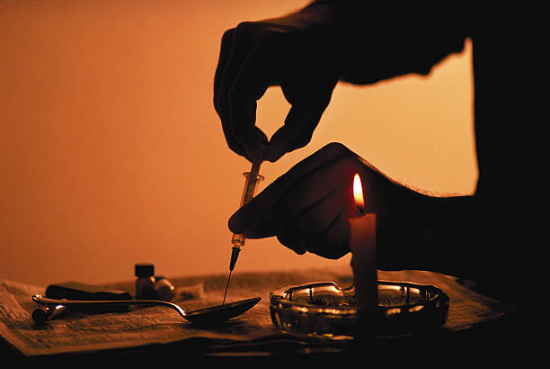
Drug Addiction

Slide 2
Drugs
A chemical substance that has known biological effects on humans or other animals
Also known as a chemical substance used in treatment cure, prevention, or diagnosis of disease
Drugs can be medical and recreational
Addiction
the need or strong desire to do or to have something, or a very strong liking for something
Is a condition in which the body relies on a given drug to help it functions
Compulsive use of drug despite any cost

Slide 3
Drug addiction
Drug addiction, also called substance use disorder, is a dependence on a legal or illegal drug or medication.
It occurs over a span of time and results in the user's inability to survive and cope without its usage or effects.
Drug abuse is more of a short term abuse of a particular drug.
The user is able to cope without it. If the usage persists and the person loses the capacity to survive without that drug, then they're considered an addict.

Slide 4
The increased levels of dopamine caused by taking drugs create feelings of pleasure and euphoria. This is what makes people want to take drugs again and again, despite the negative consequences.
WHO estimated that more than 275 million people use illicit drugs, accounting for 5.6% of the global population, and 31 million drug users have an addiction.
Approximately 2.5 million Bangladeshis are addicted to drugs, and 80% are adolescents and young people of 15–30 years.

Slide 5
Types of drug
Stimulants: Stimulants act on the central nervous system and speed you up. These increase the body's state of arousal by increasing the activity of the brain. Examples include cocaine, ecstasy (which is also a hallucinogen), meth, caffeine and nicotine.
Depressants: Depressants are chemicals that slow down the central nervous system and suppress brain activity causing relief. The most common depressants are alcohol and cannabis (marijuana/hashish).

Slide 6
Opiates: Opiate drugs provide pain relief, euphoria, sedation and in increasing doses induce coma. Examples include heroin, morphine, opium, methadone and pethidine.
Hallucinogens: Hallucinogens cause changes in a person's perception of reality. These include cannabis, LSD, ecstasy and psilocybin (magic mushrooms).

Slide 7
Physiological Causes
Getting Sleep
Staying awake
Heightening Sexual experiences
Removing pain

Slide 8
Psychological causes
Relieving Tension
Escape from reality
Relieving Boredom
Satisfying Curiosity
Alienation
Poor performance
Loss of respect and Occupation

Slide 9
Sociological causes
Family dysfuction
Peer Influence
Abuse
Role Model (follow actors)
Loss of a loved one
Failed romance
Socio-Economic Factors
Availability of drugs
Law and order situation

Slide 10
Consequences
Getting an infectious disease
Other health problems
Accidents
Suicide
Family problems
Immorality/Crime
Work issues
Problems at school
Legal issues
Financial problems

Slide 11
Steps to Reduce this Problems
Families should be aware about there Son/Daughter.
The program will strengthen the anti-drug smuggling.
Be employments.
Development and refinement of human values.
Educational Awareness from Parents.
Increased Personal and Social ability.
Leave the bad company.
Awareness building
Role of media

Slide 12
Thank you all

